Slide 1
Research on Child Trafficking
Christine Beddoe
Director
ECPAT UK. Lisbon 2012

Slide 2
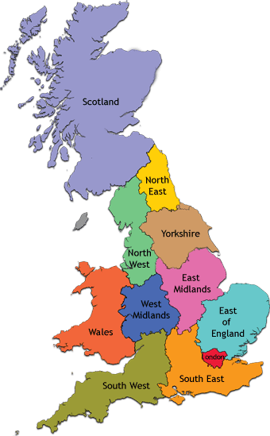
60% of trafficked children missing
North and West, 2006
Wales, 2008
London, 2001 & 2004

Slide 3
Research Method
Case Studies
Don’t say “trafficking”
More data
Increase in responses

Slide 4
Lessons Learned
Research methods must quickly adapt to level of knowledge of trafficking
Best results using multiple case scenarios
Use “multi-disciplinary” research teams
(police, immigration, social work)

Slide 5
Multi - disciplinary research
UK-Bulgaria
1 child, 16 years – 13 criminal complaints
28 journeys out of Bulgaria between 2001 -2010 with a total of 27 adults and four children. Crossed EU borders with 48 adults.
2001 – age 6/7 – travelled without parents
19 adults have a criminal record (Bulgaria, Greece, Austria, France, Germany or Italy.)

