Slide 1
International Sports Events and the increase of trafficking in human beeings
The experiences in Germany:
The Football World Cup 2006 and the campaigns against trafficking
Mechtild Maurer
ECPAT Germany

Slide 2
From Spring 2004 - Spring 2005
Fear for the Football World Cup 2006:
An increase number of cases of trafficking and forced prostitution
The following steps have been undertaken:
Analysis the situations during former sports events
Potential objectives for awareness raising activities
Potential stakeholders for measures and/or a campaign
Ideas for a wide ranging campaign

Slide 3
The Preparation Period
Some networks and organisations starts…
In 2004, some later in 2005
Some with support of professionals PR agencies (Saatchi&Saatchi)
Important role of women organisations
Important role of the churches
The focus has been more on forced prostitution,
less on trafficking of human beeing
Not in the focus:
human trafficking for forced labour and child trafficking

Slide 4
A wide range of Campaigns
The general public and the politicians
Final Whistle - Stop forced Prostitution (a broad network)
The general public, the potential victims and the clients
Take Action against trafficking and forced prostitution (Diakonisches Werk der EKD)
Red Card- www.stoppt-zwangsprostitution.de (FiM)
Look at … a woman (Schau genau ... eine Frau)
Against forced prostitution (SOLWODI
To target clients:
Responsible client: www.verantwortlicher-freier.de (BAN YING)
www.freiersein.de (Context e.V.)

Slide 5
Slogan:
Be Active Against Forced Prostitution run by
Diakonisches Werk, the social welfare institution of the protestant church in Germany
Start in 2004

Slide 6
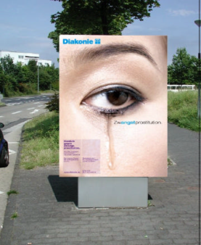
Objectives and concerns
Focus on the specific target groups of visitors of the football world cup
Together with the German Protestant Church (EKD)
To communicate the help system and the case management for victims and potential victims of trafficking and forced prostitution
To support victims
To sensitize clients not to look away
To sensitize the general public

Slide 7

Messages and Activities
Call the Hotline 0180 2006 110 (24 h call center)
Report to stoppt-zwangsprostitution@web.de
Report to the counselling centers for victms of human trafficking or to the Police
Posters – (for example in railway stations)
Postcards and leaflats (for example 650.000 Freecards)
TV-Spot in the Underground, Spot „Krystina“ in Kinos
3000 Citylight-Posters nationalwide and on the airport
Advertisment in News Papers

Slide 8
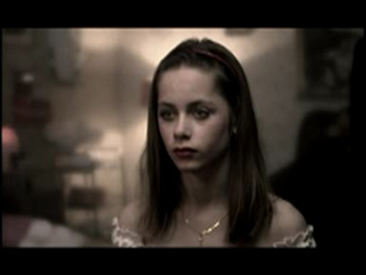
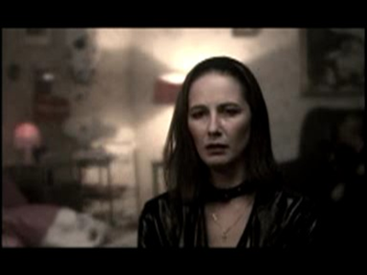
The Spot „Krystina“was the TV intro spot for the movie Lilja 4-ever in the cinemas all over Germany

Slide 9
The posters were hanging in the toilets during the world cup

Slide 10

Slogan:
Final Whistle – Stop Forced Prostitution
Under the patronage of
Klaus Wowereit
Lord Mayor of Berlin
Dr. Theo Zwanziger
Exec President of the German Football Federation DFB
Run by
amnesty international Deutschland (ai) – Bundesarbeitsgemeinschaft kommunaler Frauenbüros und Gleichstellungsstellen – Bund Deutscher Kriminalbeamter (bdk) – Bundesverband Sexuelle Dienst-leistungen (BSD) – Bundesweiter Koordinierungskreis gegen Frauenhandel und Gewalt an Frauen im Migrationsprozess e.V. (KOK) – Deutscher Frauenrat – Deutscher, Gewerkschaftsbund (DGB) – Bundes-verband Frauenberatungsstellen und Frauennotrufe, Frauen gegen Gewalt –
Internationale Arbeit sorganisation (ILO) – Männer gegen Männergewalt – Männerarbeit
der Evangelischen Kirche in Deutsch-land – Medica Mondiale – Ökumenisches Forum
Christlicher Frauen in Europa e.V. (ÖFCFE)

Slide 11

Objectives and Concerns
The goal was to put pressure on policy makers to take stronger action against these serious violations of human and women‘s rights
The campaign was not directed against football fans, clients of prostitutes or prostitutes
The campaign backed the legislation on prostitution passed in Germany in 2002 that legalises sex services under certain conditions.
Theo Zwanziger

Slide 12

Activities
The core of the action was a widespread signature campaign to support a detailed set of urgent policy recommendations to combat human trafficking and forced prostitution
We therefore urgently recommend that the German Federal Government and state Administrations do the following:
- Provide economic assistance that specifically promotes economic independence….
- Provide local counseling and aid projects….
80.000 signatures – every signatures counts

Slide 13
Activities
Launch with Klaus Wowereit and Dr. Theo Zwanziger on the 8th of March 2008
A lot of materials and street actions - for example a schedule of the matches with the campaign informations
Brochures and flyers
Whistles on a cord that featured the campaign logo and messages
Communication platform and website
Information during the whole event on the „Fan Miles“ and in the area of the public viewing

Slide 14

Additional Campaigns
In – out? Say no to forced prostitution

Slide 15
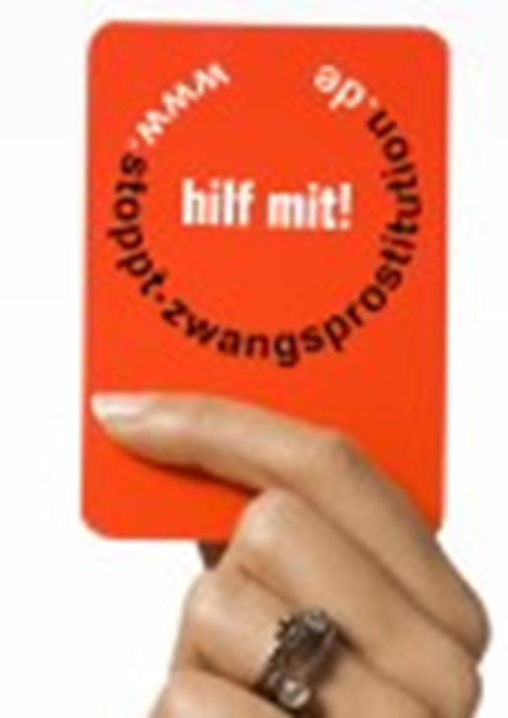


Slide 16
Evaluation and Results
The 2006 Football World Cup was enormous peaceful summer party
Most of the wellfounded fears preceding the event did not in fact materialise
Data from police and ministry said forced prostitution didn‘t inscrease during the games
Trafficking councelling centers and hotlines didn‘t register higher demands for their services during the games either
The campaigns reached more than met one of their most important goals,
namely to raise public awareness of the problem.

Slide 17

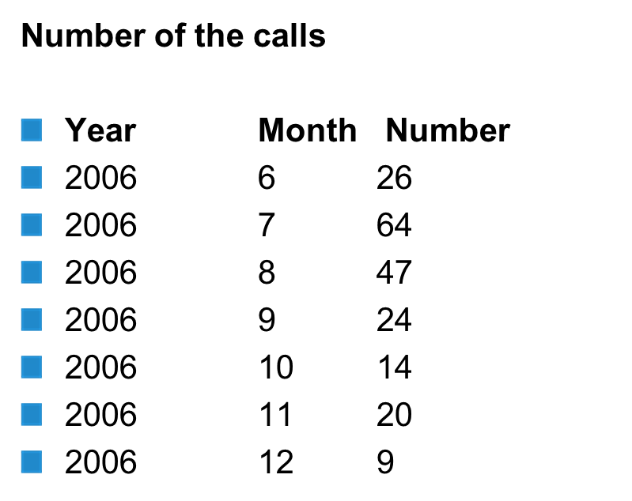
Evaluation of the Hotline 01802 331 333

Slide 18
Evaluation of the Hotline 01802 331 333
21 cases handed over to counselling centers and shelters
4 forced prostitutes
21 % Junk call
44 % women
Almost no links to the world cup

Slide 19
Some more considerations
No information and focus on trafficking in general – exploitation of labour
No information and focus on child trafficking – begging children, pickpocking children
Security measures have been so high that criminals faced a high risk
The sunny weather (including the public viewing everywhere) has been very supportive for the awareness campaign and also the high attendence of young women
Keep in mind: prostitution is legal in Germany

Slide 20

Thank you!
Mechtild Maurer
ECAPT Germany maurer@ecpat.de

